Slide 1

AJAX-6
SHARMA COMPUTER ACADEMY

Slide 2
What is fetch api ?
The Fetch API was introduced in 2015 and is used for making asynchronous HTTP requests in the browser .
It is similar to XMLHttpRequest (XHR) but :
It is a promise-based API of JavaScript .
It is simple and clean
It provides more powerful features to fetch resources from the server.

Slide 3
What is fetch api ?
Fetch API is standardized now and is supported by all modern browsers except IE.
Fetch API provides us just a single method to be called known as fetch() method.

Slide 4
How to use fetch api ?
To use Fetch API we call the fetch() method which requires only one parameter which is the URL of the resource that we want to fetch:

Slide 5
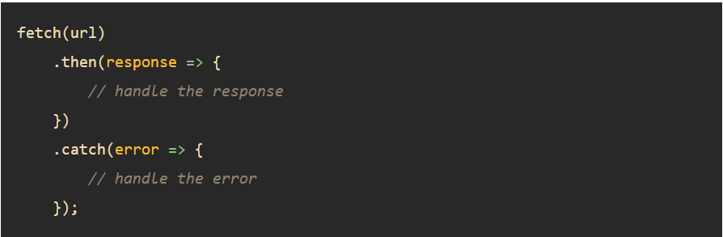
How to use fetch api ?
The fetch() method returns a Promise so we can use the then() and catch() methods to handle it:

Slide 6
Important points about fetch
When the request completes, the resource is available.
At this time, the promise will resolve into a Response object.

Slide 7
Very important point !
There is an important difference between the Response object in XHR and Fetch.
In XHR , the property responseText returns the exact same data as returned by the server while the Response object from Fetch contains information about the response object itself.

Slide 8
Very important point !
This includes all the http headers, status code, etc.
We then call various promise based methods of response object to get the data we need.

Slide 9
Response object members
The Response object provides multiple promise-based methods to access the body in various formats and two of its most popular methods are:
response.text() – read the response and return as text.
response.json() – parse the response as JSON .

Slide 10
Important points about fetch
The Response object also provides the status code and status text via the status and statusText properties.
When a request is successful, the status is 200 and statusText is OK.

Slide 11
another important point !
Another important difference between XHR and Fetch is that the Fetch API will not throw an error if the request returns a 400 or 500 status code.
Rather it will still be marked as a successful response and passed to the ‘then’ function.

Slide 12
another important point !
Fetch only throws an error if the request itself is interrupted.
To handle 400 and 500 responses, we can write custom logic using ‘response.status’.

Slide 13
Exercise-1
Write an Fetch API based application to obtain your
details from the github profile and display the
following on the page:
Image
Name
Company
Website
The url to be requested is: https://api.github.com/users/<user>

Slide 14
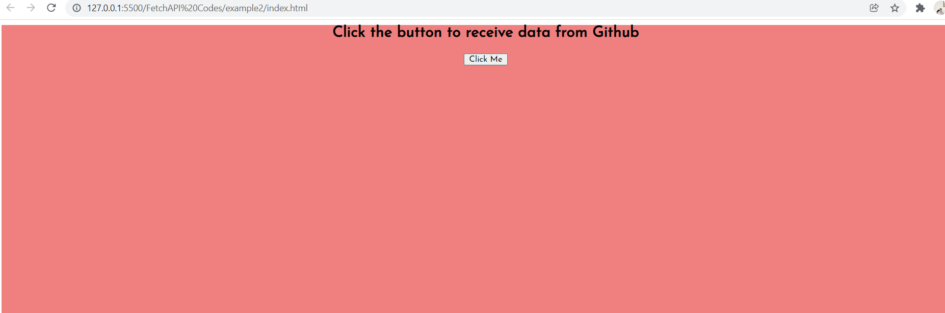
Desired output

Slide 15
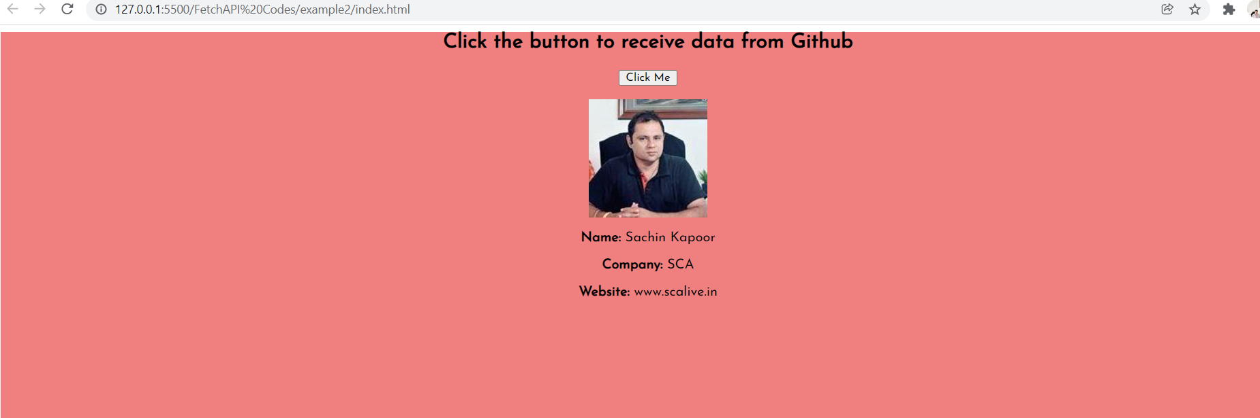
Desired output

Slide 16
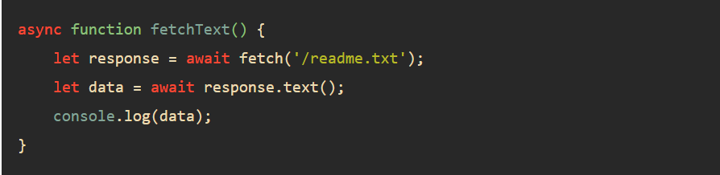
Important points about fetch
In practice, we often use the async/await with the fetch() method like this:

Slide 17
Exercise-2
Assume we have a JSON file present on the server
called team_sca_details.txt.
Write an Fetch API based application to get this file
from the server and display it on the page.

Slide 18
The json file present on server
team_sca_details.txt
[{
"username": "ksachin",
"firstName": "Sachin",
"lastName": "Kapoor",
"profileURL": "img/sachin.jpg",
"email": "sachin.k@scalive.in"
},
{
"username": "aftaab",
"firstName": "Aftaab",
"lastName": "Ahmed",
"profileURL": "img/aftaab.png",
"email": "md.aftaab@scalive.in"
},
{
"username": "yash",
"firstName": "Yash",
"lastName": "Garg",
"profileURL": "img/yash.jpg",
"email": "y.garg@scalive.in"
},
{
"username": "afroz",
"firstName": "Afroz",
"lastName": "Alam",
"profileURL": "img/afroz.jpg",
"email": "afroz.alam@scalive.in"
}
]

Slide 19
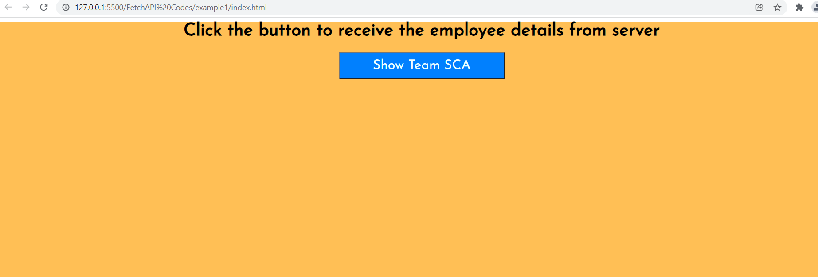
Desired output

Slide 20
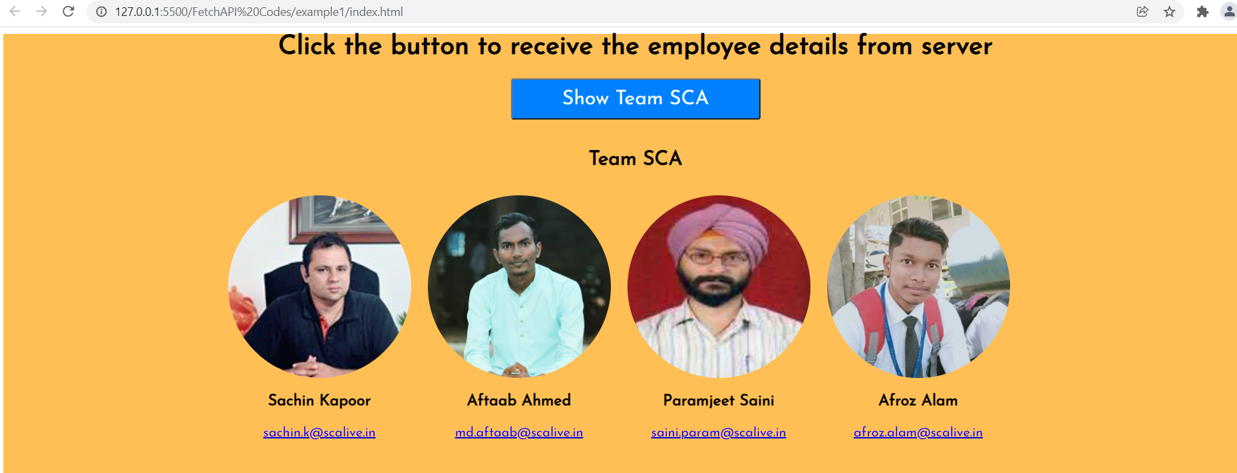
Desired output

Slide 21
Project
Write an Fetch API based application to get details
of a random person from the given api and display
the image , name , gender and phone number of the
Person.
The API to be requested
is: https://randomuser.me/api

Slide 22
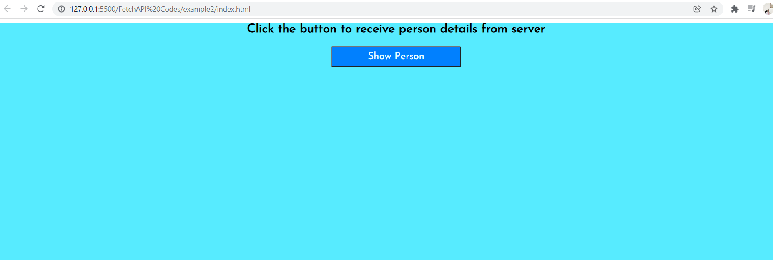
Desired output

Slide 23
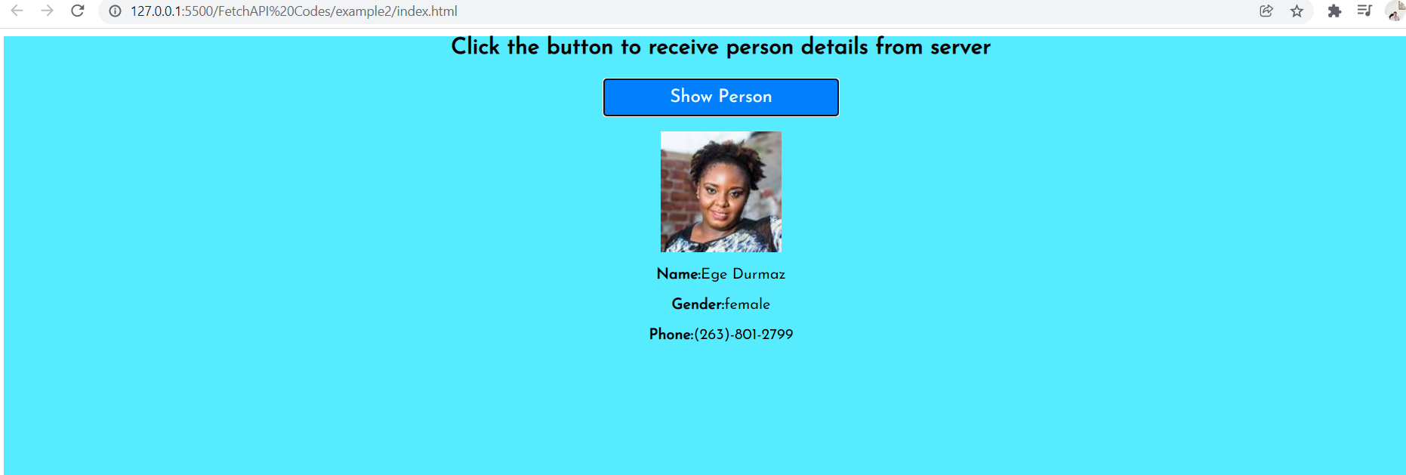
Desired output

Slide 24

Thanks!
Any questions?
You can find me at:
Email id: info@scalive.in
Contact no. : +917314853128

